Slide 1
CHAPTER 4
GLOBAL MANAGEMENT
Managing across Borders
Kapook2981/iStock/Getty Images

Slide 2
LEARNING OBJECTIVES
4-1 | Identify three influential effects on globalization.
4-2 | Describe the characteristics of a successful international manager.
4-3 | Outline the ways in which companies can expand internationally.
4-4 | Discuss barriers to free trade and ways companies try to overcome them.
4-5 | Explain the value to managers of understanding cultural differences.
4-6 | Describe how to develop your diversity, equity, and inclusion competency.

Slide 3
Working Successfully Abroad: Developing Cultural Awareness
Do Your Research.
Check Your Attitude.
Learn the Appropriate Behavior.
Become at Least Minimally Skilled in the Language.
Pack Wisely.
Finally, Be Prepared.
© McGraw Hill
Notes:
Manage U: Working Successfully Abroad: Developing Cultural Awareness
Students can develop cultural awareness when traveling abroad for pleasure or work. Cultural awareness can help ensure that international experience enhances a student’s career success. First, one should do research before even arriving in a foreign country. Second, a positive, can-do attitude should be maintained in the new country. Third, one should understand the appropriate behavior (interpersonal communication and interaction) and become at least minimally skilled in the language. Fourth, packing wisely is important as attire may differ in a foreign nation. Finally, one should be prepared with valid documentation, such as a passport, visa, etc.
Possible Topics for Discussion:
You’ve just accepted an internship at a telecommunications company in Seoul, South Korea. Before leaving for Korea, how would you plan on developing your cross-cultural awareness to ensure success?
Ask the students to form small groups and ask them to develop a to-do list of tasks that need to be completed before the trip.
Evaluate the extent to which you agree with this statement: English is considered the language of international business, and therefore, I don’t really need to learn any of the local language prior to traveling internationally.
Students should know some of the basics of the local language prior to traveling internationally. They will not have to be well versed, but it is important to learn some of the language, especially for safety reasons. Moreover, learning some of the basics in a local language shows respect for the locals one will be dealing with. Also, simply thinking that English is the best language is a sign of ethnocentrism.

Slide 4
LO 4-1
Globalization:
The Collapse of Time and Distance
Competition and Globalization: Who Will Be No. 1 Tomorrow?
The Rise of the “Global Village” and Electronic Commerce
One Big World Market: The Global Economy
Notes:
SUMMARY
Globalization, the trend of the world economy toward becoming a more interdependent system, is reflected in three developments: the rise of the “global village” and e-commerce, the trend of the world becoming one big market, and the rise of both megafirms and Internet-enabled mini-firms worldwide.

Slide 5
COMPETITION AND GLOBALIZATION:
WHO WILL BE NO. 1 TOMORROW?
Our world is changing rapidly due to globalization—the trend of the world economy toward becoming a more interdependent system. Time and distance have virtually collapsed.
It goes without saying that the world is a competitive place.

Slide 6
THE RISE OF THE “GLOBAL VILLAGE” AND ELECTRONIC COMMERCE
Global village refers to the “shrinking” of time and space as air travel and electronic media make worldwide communications easier.
By 2027, 7 billion smartphones expected.
8 billion people in the world, around 63% are Internet users and around 59% use social media.
U.S. e-commerce sales surpassed $900 billion in 2022 and are projected to reach $1.7 trillion by 2027.
Notes:
The Rise of the “Global Village” and Electronic Commerce
The International Institute for Management Development (IMD) ranks companies each year on the following four facets of competitiveness:
Economic performance
Government efficiency
Business efficiency
Infrastructure
Globalization is the trend of the world economy toward becoming a more interdependent system.
The global village refers to the “shrinking” of time and space, as air travel and electronic media have made it easier for people of the globe to communicate with each other.
One big factor driving globalization is the Internet, a worldwide computer-linked “network of networks.”

Slide 7
ONE BIG WORLD MARKET:
The GLOBAL ECONOMY
Positive Effects
The Internet, high-speed travel, and other innovations have lessened the “friction of distance,” shrinking the world and eliminating borders.
Rapid technological improvements increased communication and information sharing.
Electronic transfers have increased access to capital.
Foreign firms in some industries are building plants in the United States.
Negative Effects
Large-scale effects of the rise of global economy have included much-publicized job losses across the United States.
Potential threats to information security because data must be shared.
If a nation is heavily depended on by others, and its economy falters, there can be instant regional or global instability.
Notes:
One Big World Market: The Global Economy
The demise of communism, the opening of economies to foreign trade by Asian countries, and deregulation of economies have created a global economy.
Positives of a global economy are that there is now a worldwide market for companies and consumers who have access to products of different countries.
Negative effects of the global economy include organizations in the United States offshoring jobs to less expensive labor markets. Managers at companies in participating in the global economy are challenged by risks that include data security, loss of quality control, and the risk of hidden or unanticipated costs.

Slide 8
LO 4-2
You and International Management
Why Learn about International Management?
The Successful International Manager: Geocentric, Not Ethnocentric or Polycentric
Notes:
SUMMARY
Studying international management prepares you to work with foreign customers or suppliers, for a foreign firm in the United States, or for a U.S. firm overseas. Successful international managers aren’t ethnocentric or polycentric but geocentric.

Slide 9
INTERNATIONAL MANAGEMENT
Business firm with operations in several countries.
Nonprofit organization with operations in several countries.
Multinational Corporation
Multinational Organization
Notes:
Working Overseas
Working overseas can be an advantage to your career.
In today’s global economy, it’s more than likely that you’ll engage with international colleagues, suppliers, customers, or vendors.
Why Learn About International Management?
International management is management that oversees the conduct of operations in or with organizations in foreign countries.
A multinational corporation, or multinational enterprise, is a business with operations in several countries.
A multinational organization is a nonprofit organization with operations in several countries.

Slide 10
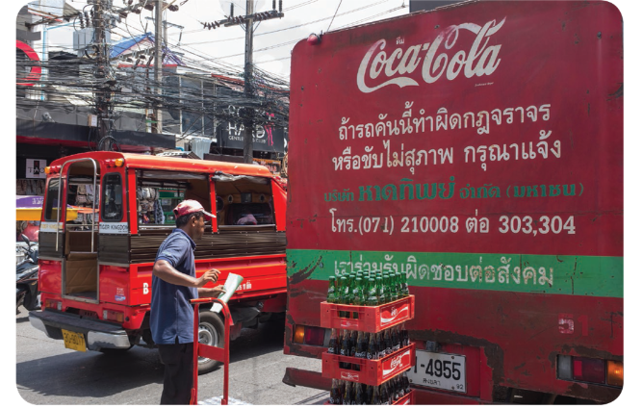
WHY LEARN ABOUT INTERNATIONAL MANAGEMENT?
You may:
Deal with foreign customers or partners.
Deal with foreign employees or suppliers.
Work for a foreign firm in the United States.
Lou Linwei/Alamy Stock Photo
Notes:
Even if you never travel outside North America, the world will assuredly come to you.
You may deal with foreign customers or partners.
You may deal with foreign employees or suppliers.
You may work for a foreign firm in the United States.
You may work for an American firm outside the United States or for a foreign one.

Slide 11
THE SUCCESSFUL INTERNATIONAL MANAGER: GEOCENTRIC, NOT ETHNOCENTRIC OR POLYCENTRIC
Ethnocentric managers—“We know best.”
Polycentric managers—“They know best.”
Geocentric managers—“What’s best is what’s effective, regardless of origin.”
Notes:
Ethnocentric Managers—“We Know Best”
Ethnocentric managers believe that their native country, culture, language, and behavior are superior to all others.
The ethnocentric viewpoint is often more attributable to ignorance. For example, as compared to conscious prejudice. Studies suggest building cross-cultural awareness makes us less likely to hold ethnocentric viewpoints
Ethnocentrism might also be called parochialism—that is, a narrow view in which people see things solely through their own perspective.
Polycentric Managers—“They Know Best”
Polycentric managers believe that native managers best understand native personnel and practices in their home countries, so the home office should defer to the native manager.
The attitude of polycentric managers is nearly the opposite of that of ethnocentric managers.
Geocentric Managers—“What’s Best Is What’s Effective, Regardless of Origin”
Geocentric managers accept that there are differences and similarities between home and foreign personnel and practices.
They believe they should use whichever techniques are most effective.
This view takes more work than being an ethnocentric or polycentric manager, but the payoff can be far greater.

Slide 12
SELF-ASSESSMENT 4.1
Assessing Your Consumer Ethnocentrism
This survey is designed to assess your consumer ethnocentrism. Please complete Self-Assessment 4.1 if your instructor has assigned it in Connect.
Insert your class results here.
Insert your class results here or do the assessment during class.
Notes:
Assessing Your Consumer Ethnocentrism
STUDENT QUESTIONS
1. Are you surprised by the results? What do they suggest about your purchasing decisions? What are the pros and cons of being an ethnocentric consumer?
Student responses will differ based on assessment results. Many students will be surprised at their high level of ethnocentrism. Many people have not really thought deeply about their purchasing decisions, and how ethnocentric they may be. Being ethnocentric is good to the point that it supports your nation’s economy and survival in the global market. But being too ethnocentric causes people to be closed-minded and very nationalistic. There is an advantage to having trade around the world, and that should be appreciated to an extent.
2. How do American companies, associations, and unions encourage us to be ethnocentric consumers?
Many American companies label products “Made in the USA” in order to promote American products as the standard of excellence. Moreover, these organizations are signaling that American products should be purchased to support the nation’s economy. Many associations and unions have been established just for American products. For example, the websites www.madeintheusa.com and www.americansworking.com are dedicated to just pinpointing American products.
ADDITIONAL ACTIVITIES
In this activity, students should be assigned to groups based on their scores for Self-Assessment 4.1. Students with a high ethnocentrism score should be grouped together, and students with a low ethnocentrism score should be grouped together. Students with high ethnocentrism scores should discuss the challenges associated with ethnocentrism. Have the students consider the harm high ethnocentrism can cause in an organization. Students with low ethnocentrism scores should discuss ways to reduce ethnocentrism in their organizations (policies, behavior, etc.). Some questions to consider:
1. How does high ethnocentrism affect behaviors in groups/teams and hinder motivation in the workplace? What diversity issues can exhibit themselves?
2. Are students aware of any particular policies at organizations (current employer or previous employer, or something they read in the news) that target ethnocentrism?
Groups should present for the class, and you should further point out challenges associated with high ethnocentrism.

Slide 13
LO 4-3
Why and How Companies Expand Internationally
Why Companies Expand Internationally
How Companies Expand Internationally
Notes:
SUMMARY
Multinationals expand to take advantage of availability of supplies, new markets, lower labor costs, access to finance capital, or avoidance of tariffs and import quotas. Five ways they do so are by global outsourcing; importing, exporting, and countertrading; licensing and franchising; joint ventures; and wholly owned subsidiaries.

Slide 14

WHY COMPANIES EXPAND INTERNATIONALLY
Availability of supplies
New markets
Lower labor costs
Access to finance capital
Avoidance of tariffs and import quotas
Boule/Shutterstock
Notes:
Why Companies Expand Internationally
Companies may have to go where their basic supplies or raw materials are located.
Companies can reach new markets and can make money overseas when demand for their products decreases at home.
Firms might be able to lower their labor costs, for example through using maquiladoras, manufacturing plants allowed to operate in Mexico with special privileges in return for employing Mexican citizens, thus providing less expensive labor.
Companies may be able to access needed finance capital.
Tariffs or import quotas can be avoided by establishing subsidiaries in foreign locations.

Slide 15
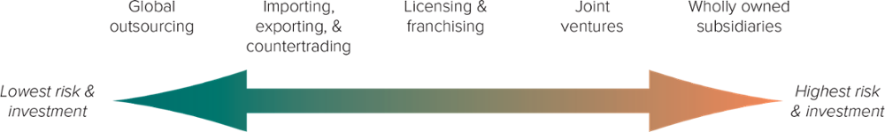
HOW COMPANIES EXPAND INTERNATIONALLY
These range from lowest risk and investment (left) to highest risk and investment (right).
Access the text alternative for slide images.
Notes:
How Companies Expand Internationally
Most companies enter international business in one of five ways.
Figure 4.1 shows the entry modes ranging from the lowest risk and investment to the highest risk and investment.
Global Outsourcing
Outsourcing is defined as using suppliers outside the company to provide goods and services.
Global outsourcing or offshoring is defined as using suppliers outside the United States to provide labor, goods, or services.
There are several reasons for global outsourcing including availability of resources, special expertise, or cheaper labor.
As a result of the complexities of outsourcing, some U.S. companies are engaging in reshoring, or moving production back home.
Importing, Exporting, and Countertrading
When importing, a company buys goods outside the country and resells them domestically.
When exporting, a company produces goods domestically and sells them outside the country.
Countries can also resort to countertrading—bartering goods for goods—if they lack currency to pay for the goods.
Licensing and Franchising
In licensing, a company allows a foreign company to pay a fee to make or distribute the first company’s product or service.
The licensor can make money without investing large sums to conduct business directly in a foreign company.
The local firm, the licensee, knows the local market better than the U.S. company would.
Franchising is a form of licensing in which a company allows a foreign company to pay it a fee and a share of the profit in return for using the first company’s brand name and a package of materials and services.
Joint Ventures
A U.S. firm may form a joint venture, also known as a strategic alliance, with a foreign company to share the risks and rewards of starting a new enterprise together in a foreign country.
Laws in some countries forbid foreigners from ownership; a joint venture is the only option to enter that market.
Wholly Owned Subsidiaries
A wholly owned subsidiary is a foreign subsidiary that is totally owned and controlled by another organization.
A greenfield venture is a foreign subsidiary that the owning organization has built from scratch.

Slide 16
TOP EXPORTING COUNTRIES, 2021
China
United States
Germany
Netherlands
Japan
Hong Kong
South Korea
Italy
France
Belgium
TABLE 4.1
Source: “Leading Export Countries Worldwide in 2021,” Statista, Aug 5, 2022.
https://www.statista.com/statistics/264623/leading-export-countries-worldwide/.

Slide 17
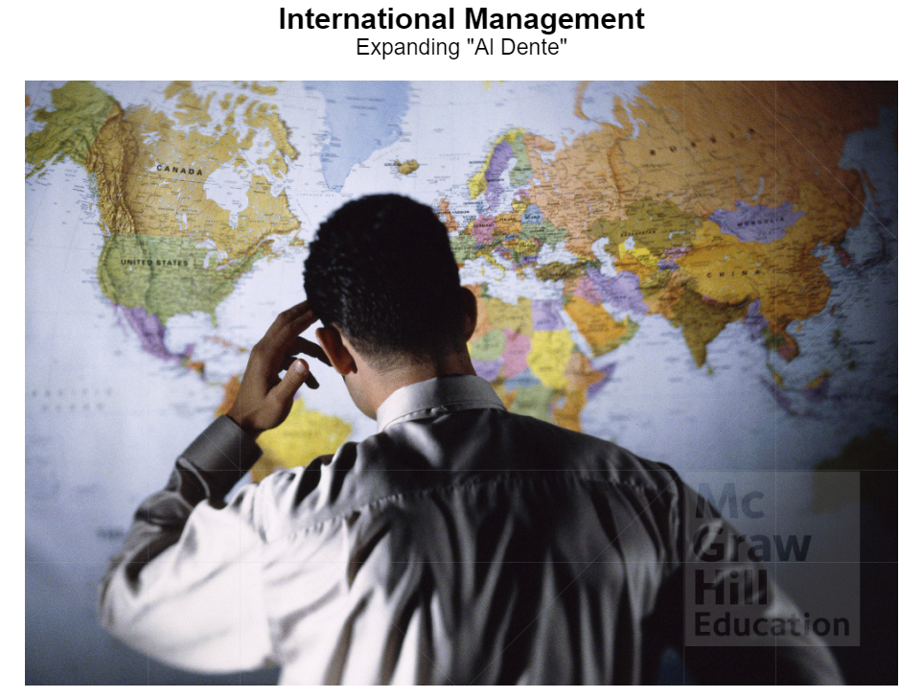
Application-Based Activity
International Management: Expanding Al Dente
Ingram Publishing
Notes:
Chapter 4 ABA: International Management: Expanding Al Dente
Context
Students will assist Gina, the owner of Gina's Pasta Store, to decide about an international expansion. The store has an excellent reputation in the United States. Sales are soaring and the homemade pasta store is gaining brand popularity by the day. Gina wants to expand outside the United States and tap into an international market. She has promoted the person in the student’s role to International Operations Manager and would like them to guide her on the best course of action to expand outside the United States.
Instructions
Put students in groups of 3-4 and explain that they are going to be presented with information regarding an international expansion. They will play the role of the international operations manager in helping the company owner to make and execute an expansion decision.
You will control the simulation for the entire class and lead them through the decision-making process. Begin by starting the simulation on your laptop or classroom computer. This opens a screen containing an activity description and the learning objectives. Have students read this material. Then select begin to start the simulation.
You then need to select an avatar for the role of international operations manager being played by your students and a player name (select whatever you want). Hit continue. You will be given titles and names for the three people involved in this situation: Gina (store owner), Hank (marketing manager), and Narrator. Hit play.
Framing the Decision
You will encounter multiple interactions among Gina, Hank, and the international operations manager being played by your students. Continue the simulation through the graphs of international pasta consumption and price tolerance for pasta. Ask students to interpret each graph as you encounter them. Discuss and then hit continue.
You will arrive at a decision point in which Gina asks Hank and the person playing the student role to decide on which of four countries the company should consider expanding to. This is the core decision underlying the simulation. It’s time for some critical thinking.
Give the groups 5 minutes to make a decision and provide their rationale. Ask the groups to report out and keep a tally on a whiteboard. Drive for a consensus via discussion and a vote and then make your choice. The correct answer is Mexico but select whatever choice your students come up with because the simulation loops back until to select Mexico.
Executing the Decision
The next probe focuses on remembering the details of three different trading blocs. Ask the class as a whole to recommend an answer and seek a consensus. The correct answer is the USMCA. Hit submit and then continue.
The simulation then provides information about risk levels for segments of Mexican society: Political, legal, consumer protections, and monetary. Hit continue.
The next probe focuses on different ways the company might expand internationally. Give the groups 5 minutes to decide on a recommendation: Network is a distractor and export and wholly owned subsidiary are viable options. Ask the groups to report out and keep a tally. Ask each group to provide the rationale for its decision and seek a consensus. Select whatever the class decides. This decision branches. Whether you select export or wholly owned subsidiary, the simulation continues down that branch and provides the same type of outcomes. It is important to note that the answer of “export” is more appropriate because it is less risky.
If you select “wholly owned subsidiary,” you will find it contains too much risk and ultimately leads the Mexican government to establish tariffs on pasta. Simply follow the simulation and ask the class to answer the decision prompts.
Selecting export then leads to another decision about “how” to expand. This probe essentially focuses on the definition of exporting. The correct answer is manufacture in the U.S. and then ship to Mexico. Don’t worry about selecting the wrong answer as this probe loops back until you select the correct answer.
The next probe reveals that the Mexican government initiated a tariff on pasta and it asks about the definition of a tariff. Simply ask the class the answer this one. The correct answer is that tariffs mean there is an additional tax on pasta imports. Continue the simulation till its ending answering the probes with the entire class.
You might conclude by summarizing conclusions during the deliberations and then ask for a key takeaway from analyzing this case.

Slide 18
LO 4-4
The World of Free Trade: Regional Economic Cooperation and Competition
Barriers to International Trade
Organizations Promoting International Trade
Major Trading Blocs
Most Favored Nation Trading Status
Exchange Rates
The BRICS Countries: Important International Competitors
Notes:
SUMMARY
Barriers to free trade include tariffs, import quotas, and embargoes. Organizations promoting international trade are the World Trade Organization, the World Bank, and the International Monetary Fund. We discuss two major trading blocs, NAFTA (now USMCA) and the EU. Major competitors with the United States are the “BRICS” countries—Brazil, Russia, India, China, and South Africa.

Slide 19
TOP U.S. TRADING PARTNERS IN GOODS, NOVEMBER 2022
Top 10 Nations the United States EXPORTS TO
Top 10 Nations the United States IMPORTS FROM
Canada
Mexico
China
United Kingdom
Japan
Germany
Netherlands
South Korea
India
France
China
Mexico
Canada
Germany
Japan
South Korea
Vietnam
Taiwan
Ireland
India
Notes:
From Table 4.2.

Slide 20
BARRIERS TO INTERNATIONAL TRADE
Trade protectionism
Tariff:
  A trade barrier in the form of a customs duty, or tax, levied mainly on imports.
Import Quota:
  A trade barrier in the form of a limit on the quantity of a product that can be imported.
Sanction:
  The trade prohibition on certain types of products, services, or technology to another country for specific reasons, including nuclear nonproliferation, terrorism, and humanitarian concerns.
Embargo:
  A complete ban or prohibition of trade of one country with another so that no goods or services can be imported or exported.
Notes:
Barriers to International Trade
Free trade is the movement of goods and services among nations without political or economic obstruction.
Countries often use trade protection—the use of government regulations to limit the import of goods and services—to protect their domestic industries against foreign competition.
Tariffs:
A tariff is a trade barrier in the form of a customs duty or tax levied mainly on imports.
A revenue tariff is designed simply to raise money for the government.
A protective tariff raises the price of imported goods to make the prices of domestic products more competitive.
Import Quotas:
An import quota is a trade barrier in the form of a limit on the quantity of a product that can be imported.
The intent of an import quota is to protect domestic industry by restricting the availability of foreign products.
Sanctions and Embargoes:
A sanction is the trade prohibition on certain types of products, services, or technology to another country for specific reasons.
An embargo is a complete ban or prohibition of trade of one country with another.
Sanctions may be considered “partial embargoes” because they restrict trade in certain areas.

Slide 21
ORGANIZATIONS PROMOTING
INTERNATIONAL TRADE
1. World Trade Organization
2. World Bank
3. International Monetary Fund
The three principal organizations designed to facilitate international trade:
Notes:
Organizations Promoting International Trade
Post World War II, the advanced nations of the world began to realize that if all countries could freely exchange what each could produce most efficiently, prices would decrease all around.
Nations began to focus on the removal of barriers to free trade.
Three principal organizations designed to facilitate international trade were formed.
World Trade Organization
World Bank
International Monetary Fund (IMF)

Slide 22
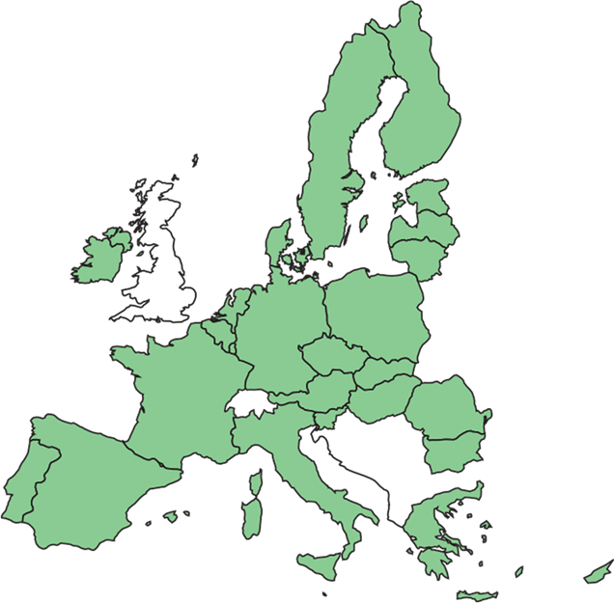
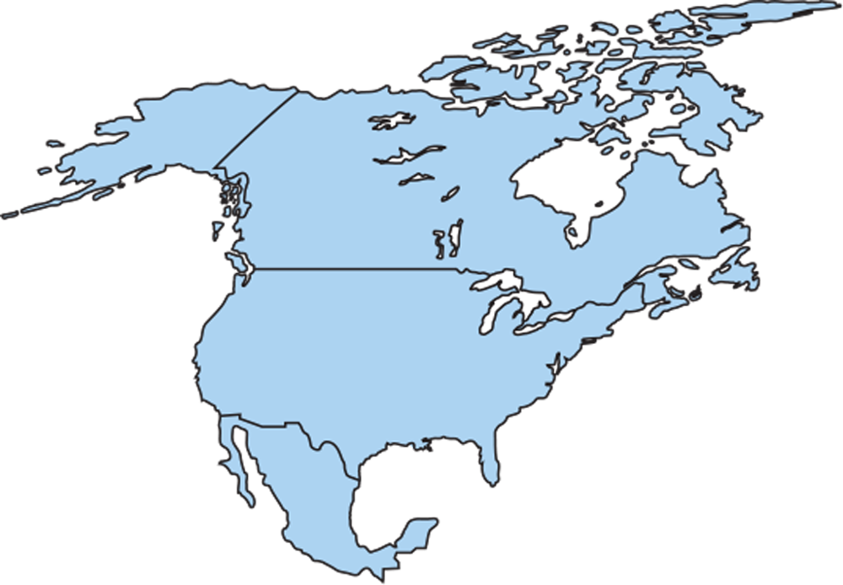
MAJOR TRADING BLOCS
United States-Mexico-Canada
Agreement (USMCA)
EU—The 27 Countries of the European Union
A trading bloc is a group of nations within a geographical region that have agreed to remove trade barriers with one another.
Notes:
Major Trading Blocs
A trading bloc, also known as an economic community, is a group of nations within a geographical region that have removed trade barriers with one another.
Two major trading blocs are the NAFTA nations and the European Union.
North American Free Trade Agreement (NAFTA) and United States-Mexico-Canada Agreement (USMCA)
The North American Free Trade Agreement (NAFTA) was a trading bloc consisting of the United States, Canada, and Mexico.
The United States, Mexico, and Canada renegotiated NAFTA in November 2018, drafting a new policy known as the United States-Mexico-Canada Agreement (USMCA).
The new agreement includes new chapters covering digital trade, anti-corruption, and good regulatory practices.
European Union (EU)
The European Union (EU) is a trading bloc consisting of 27 countries in Europe.
Nearly all internal trade barriers were eliminated, including the movement of labor between countries.
Many national currencies have been replaced with the EU currency, the euro.
One of the most significant events impacting the EU in the past decade was the United Kingdom’s exit from the trade block, an event known as BREXIT (a combination of Britain and exit).

Slide 23
MOST FAVORED NATION TRADING STATUS
Most Favored Nation trading status describes a condition in which a country grants other countries favorable trading treatment such as the reduction of import duties.
Notes:
Most Favored Nation Trading Status
With most favored nation trading status, a country grants other countries favorable trading treatment such as the reduction of import duties.
The purpose is to promote stronger and more stable ties between the countries.

Slide 24

EXCHANGE RATES
Exchange rate is the rate at which the currency of one area or country can be exchanged for the currency of another.
Values of currencies fluctuate in relation to each other due to changing economic conditions.
Maria Toutoudaki/Photodisc/Getty Images
Notes:
Exchange Rates
The exchange rate is the rate at which the currency of one country can be exchanged for the currency of another.
Because of changing economic conditions, the values of currencies fluctuate in relation to each other.

Slide 25
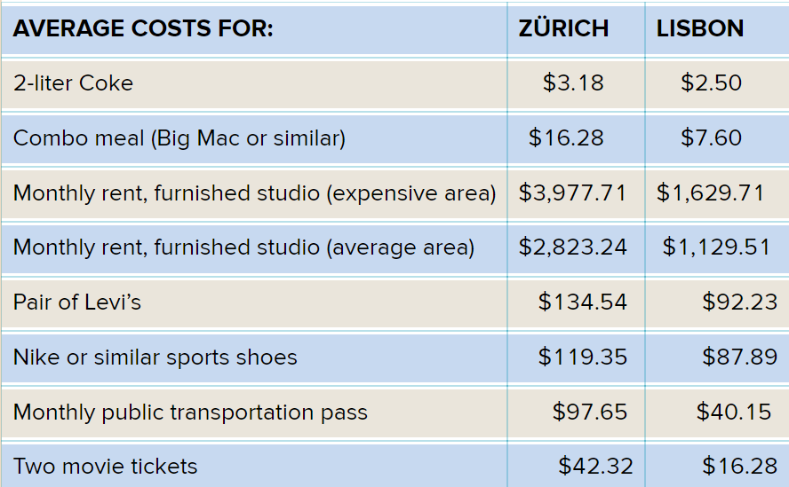
COMPARISON OF PRICES IN ZURICH AND LISBON

Slide 26
THE BRICS COUNTRIES: IMPORTANT INTERNATIONAL COMPETITORS
The term BRICS stands for the five major emerging economies of:
  Brazil, Russia, India, China, and South Africa
Though not a trading bloc as such, the BRICS are important because they hold 40% of the world’s population.
Notes:
The BRICS Countries: Important International Competitors
The term BRICS stands for the five major emerging economies of Brazil, Russia, India, China, and South Africa.
The BRICS are important because they make up 40 percent of the world’s population.
China:
China’s economy is currently the second largest in the world after that of the United States.
Analysts predict that both China and India may surpass the United States by 2075.
India:
India’s population grew to surpass China’s in early 2023.
India’s advantages are its large English-speaking population, its technological and scientific expertise, and its reputation in services.
Brazil:
As one of the top 10 largest economies in the world, Brazil benefits from agriculture, mining, manufacturing, and services,
Brazil experienced a decade of economic and social progress from 2003 to 2013.
After struggling for several years with inflation and unemployment, Brazil's economy seems to be making a slow comeback.

Slide 27
LO 4-5
The Value of Understanding
Cultural Differences
The Importance of National Culture
Cultural Dimensions: The Hofstede and GLOBE Project Models
Other Cultural Variations: Language, Interpersonal Space, Communication, Time Orientation, Religion, and Law and Political Stability
U.S. Managers on Foreign Assignments: Why Do They Fail?
Notes:
SUMMARY
Managers trying to understand other cultures need to understand the importance of national culture and cultural dimensions and basic cultural perceptions embodied in language, interpersonal space, communication, time orientation, religion, and law and political stability.

Slide 28
THE IMPORTANCE OF
NATIONAL CULTURE
Culture is the shared set of beliefs, values, knowledge, and patterns of behavior common to a group of people.
Low-context culture, in which shared meanings are primarily derived from written and spoken words.
High-context culture, in which people rely heavily on situational and nonverbal cues for meaning when communicating with others.
Purestock/Getty Images
Notes:
The Importance of National Culture
Cross-cultural awareness is defined as the ability to operate in different cultural settings.
A nation’s culture is the shared set of beliefs, values, knowledge, and patterns of behavior common to a group of people.
We begin learning our culture starting at an early age through everyday interaction with people around us.
Because a culture is made up of so many nuances, visitors to a different and unfamiliar culture may experience feelings of discomfort and disorientation.

Slide 29
CULTURAL DIMENSIONS: THE HOFSTEDE AND GLOBE PROJECT MODELS
Hofstede’s Model
GLOBE Project
Individualism/Collectivism
Power distance
Uncertainty avoidance
Masculinity/femininity
Power distance
Uncertainty avoidance
Institutional collectivism
In-group collectivism
Gender egalitarianism
Assertiveness
Future orientation
Performance orientation
Humane orientation
Notes:
Cultural Dimensions: Hofstede’s and GLOBE Project Models
In low-context cultures, shared meanings are primarily derived from written and spoken words.
In high-context cultures, people rely heavily on situational cues for meaning when communicating with others.
Geert Hofstede collected data from 116,000 IBM employees in 53 countries and proposed four dimensions along which national cultures can be placed.
The dimensions are:
Individualism/collectivism: how much people prefer a loosely knit social framework in which people are expected to take care of themselves, or a tightly knit social framework in which people and organizations are expected to look after each other.
Power distance: the degree to which people accept inequality in social situations.
Uncertainty avoidance: people’s intolerance for uncertainty and risk.
Masculinity/femininity: how much people value performance-oriented traits or how much they embrace relationship-oriented traits.
The GLOBE project is an ongoing cross-cultural investigation of nine cultural dimensions involved in leadership and organizational processes.
The dimensions are:
Power distance: the degree to which a society’s members expect power to be unequally shared.
Uncertainty avoidance: the extent to which a society relies on social norms and procedures to alleviate the unpredictability of future events.
Institutional collectivism: the extent to which individuals are encouraged and rewarded for loyalty to the group as opposed to pursuing individual goals.
In-group collectivism: the extent to which people should take pride in being members of their family, circle of close friends, and work organization.
Gender egalitarianism: the extent to which a society should minimize gender discrimination and role inequalities.
Assertiveness: the extent to which a society expects people to be confrontational and competitive as opposed to tender and modest.
Future orientation: the extent to which a society encourages investment in the future, as by planning and saving.
Performance orientation: the extent to which society encourages and rewards its members for performance improvement and excellence.
Humane orientation: the degree to which individuals are encouraged to be altruistic, caring, kind, generous, and fair.
The GLOBE dimensions illuminate the interesting variety of cultural patterns around the world.
Knowing the cultural tendencies of foreign business partners and competitors can give you a strategic competitive advantage.

Slide 30
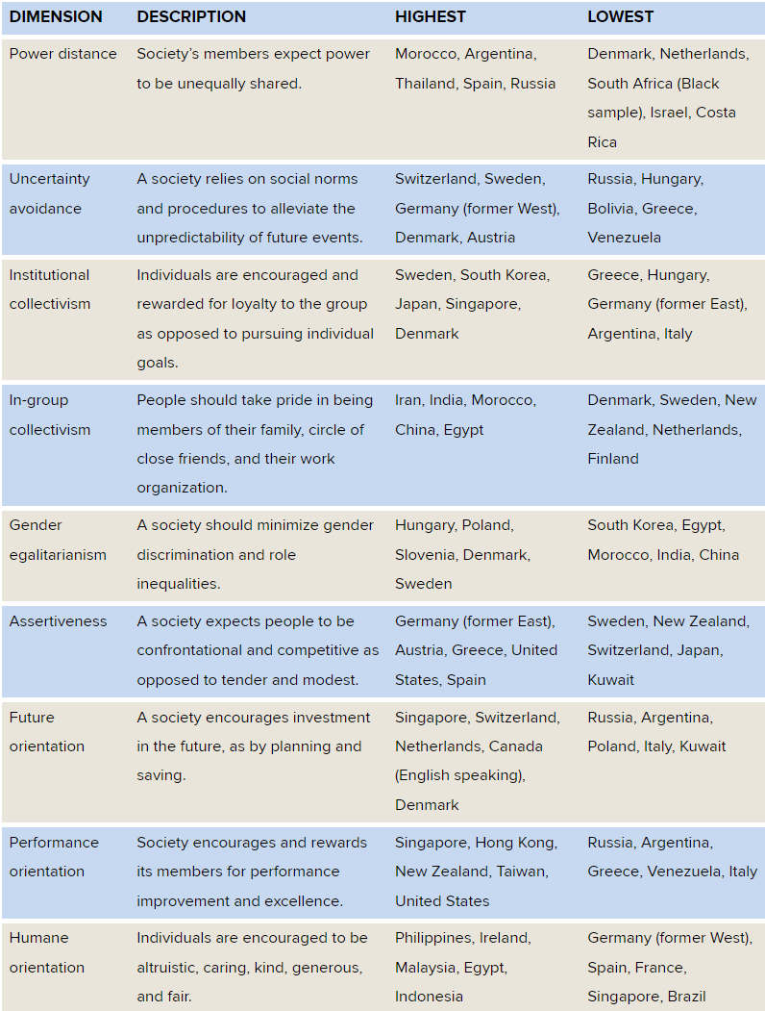
CULTURAL DIMENSIONS: THE GLOBE PROJECT

Slide 31
SELF-ASSESSMENT 4.2
CAREER READINESS
Assessing Your Standing on the GLOBE Dimensions
This survey is designed to assess your values in terms of the GLOBE dimensions. Please complete Self-Assessment 4.2 if your instructor has assigned it in Connect.
Add your class results here.
Insert your class results here or do the assessment during class.
Notes:
Assessing Your Consumer Ethnocentrism
STUDENT QUESTIONS
1. Are you surprised by the results? What do they suggest about your purchasing decisions? What are the pros and cons of being an ethnocentric consumer?
Student responses will differ based on assessment results. Many students will be surprised at their high level of ethnocentrism. A lot of people have not really thought deeply about their purchasing decisions, and how ethnocentric they may be. Being ethnocentric is good to the point that it supports your nation’s economy and survival in the global market. But being too ethnocentric causes people to be closed-minded and very nationalistic. There is an advantage to having trade around the world, and that should be appreciated to an extent.
2. How do American companies, associations, and unions encourage us to be ethnocentric consumers?
Many American companies label products “Made in the USA” in order to promote American products as the standard of excellence. Moreover, these organizations are signaling that American products should be purchased to support the nation’s economy. Many associations and unions have been established just for American products. For example, the websites www.madeintheusa.com and www.americansworking.com are dedicated to just pinpointing American products.
ADDITIONAL ACTIVITIES
In this activity, students should be assigned to groups based on their scores for Self-Assessment 4.1. Students with a high ethnocentrism score should be grouped together, and students with a low ethnocentrism score should be grouped together. Students with high ethnocentrism scores should discuss the challenges associated with ethnocentrism. Have the students consider the harm high ethnocentrism can cause at an organization. Students with low ethnocentrism scores should discuss ways to reduce ethnocentrism at their organizations (policies, behavior, etc.). Some questions to consider:
1. How does high ethnocentrism affect behaviors in groups/teams and hinder motivation in the workplace? What diversity issues can exhibit themselves?
2. Are students aware of any particular policies at organizations (can be current or previous employer, or something they read in the news) that target ethnocentrism?
Groups should present for the class, and you should further point out challenges associated with high ethnocentrism.

Slide 32
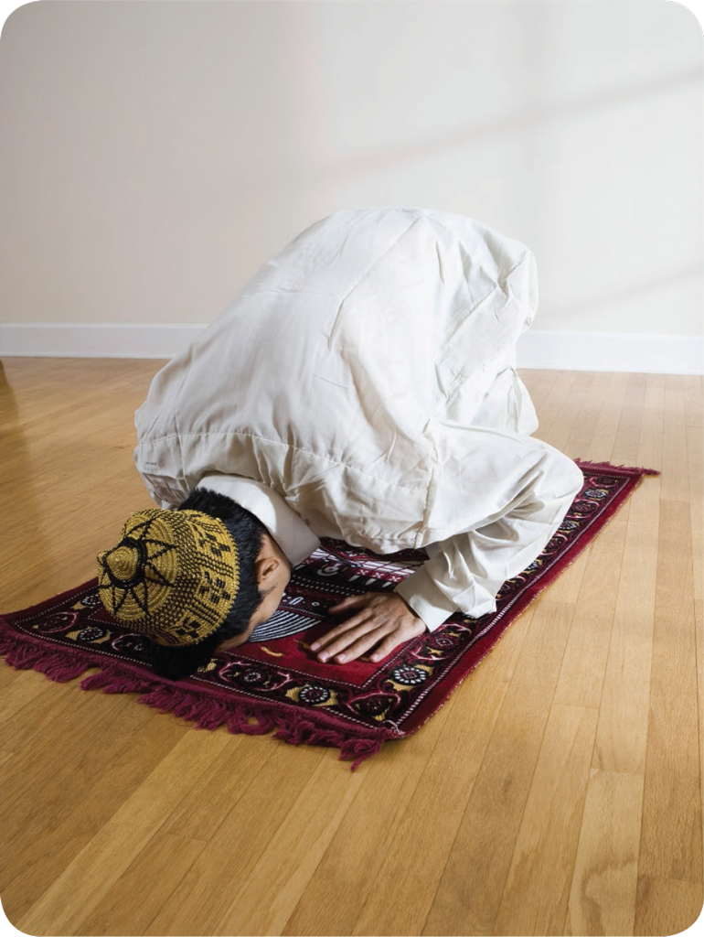
OTHER CULTURAL VARIATIONS
Cultural Variations:
  Language
  Interpersonal space
  Communication
  Time orientation
  Religion
  Law and political stability
Purestock/Getty Images
Notes:
Other Cultural Variations
Language:
More than 7,100 different languages are spoken throughout the world.
Even though global business speaks English, Mandarin Chinese, Hindi, and Spanish consistently top the lists of the world’s most spoken languages.
In communicating across cultures, you have four options:
Speak your own language.
Use a translator.
Use a translation app that turns a smartphone into an interpreter.
Learn the local language.
Interpersonal Space:
Interpersonal space measures how close or far away one should be when communicating with another person.
People of different cultures have different ideas about what is acceptable interpersonal space.
North Americans and Europeans conduct business conversations at a range of 3.1 to 3.4 feet.
Communication:
Cross-cultural communication competence plays a critical role for expatriates to communicate effectively.
Time Orientation:
Monochronic time is a preference for doing one thing at a time.
Time is viewed as being limited, precisely segmented, and schedule driven.
Polychronic time is a preference for doing more than one thing at a time.
Time is viewed as being flexible and multidimensional.
This prevails in Mediterranean, Latin American, and Middle Eastern cultures.
Religion:
There are wide variations in work-related values for different religious affiliations.
Managers should consider the impact of religious traditions that inform various cultures around the world.
Figure 4.3 shows major religions by geographic area.
Research suggests that a country's or a region’s predominant religious traditions influence a host of business-related factors, including corporate accounting practices, risk-taking behaviors, and advertising decisions.
Law and Political Stability:
Firms operating abroad must deal with other countries’ laws and business practices and make calculations about political risk.
Among the risks an organization might experience abroad are instability, expropriation, corruption, and labor abuses.
Even in a developed country a company may be encounter political instability, such as riots or civil disorders.
Firms should be concerned about expropriation, a government’s seizure of a domestic or foreign company’s assets.
Although the United States is relatively free of corruption, bribery is an acceptable and frequent practice in other countries. The Foreign Corrupt Practices Act makes it illegal for employees of U.S. companies to make “questionable” or “dubious” contributions to political decision makers in foreign nations.
Working conditions can be harsh, and labor abuse such as slavery occurs in some countries.

Slide 33
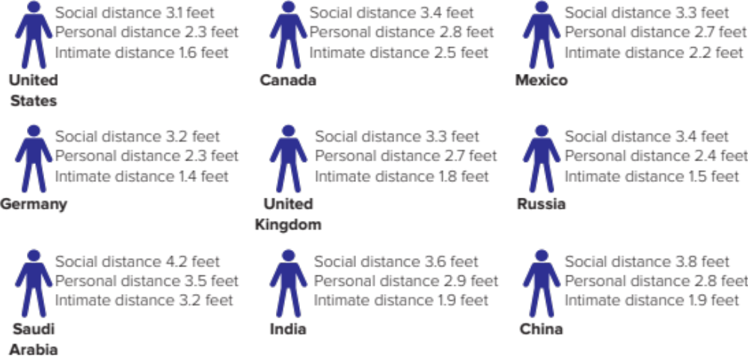
Comfortable Interpersonal Space for Different Countries
Source: Data taken from A. Sorokowska, P. Sorokowski, P. Hilpert, K. Cantarero, T. Frackowiak, K. Ahmadi, et al, “Preferred Interpersonal Distances: A Global Comparison,” Journal of Cross-Cultural Psychology, March 2017, pp. 577–592.
Access text description for slide image.

Slide 34
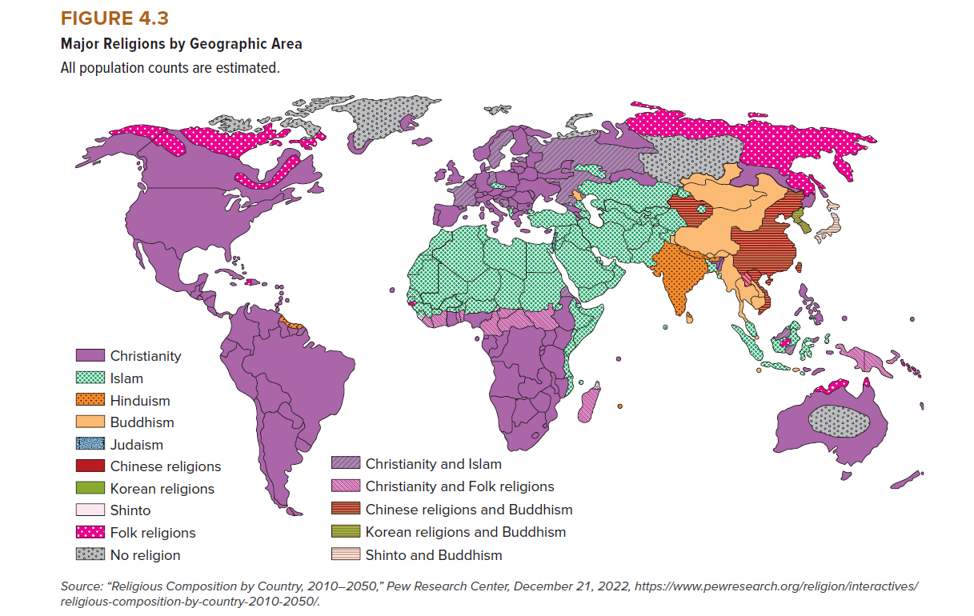
Major Religions OF THE WORLD
Access text description of slide image.

Slide 35
U.S. MANAGERS ON FOREIGN ASSIGNMENTS: WHY DO THEY FAIL?
Expatriates—people living or working in a foreign country. It can be very costly to support expatriates and their families.
Issues:
Expatriate Selection
Ongoing Expatriate Adjustments
Repatriation
Notes:
U.S. Managers on Foreign Assignments: Why Do They Fail?
Expatriates are people living or working in a foreign country.
Using expatriate managers is expensive, and some expatriate managers have trouble adjusting to their host country's cultures, which can lead to poor performance, decreased well-being, and higher turnover rates.
Firms who leverage expatriate managers should carefully evaluate the selection process, the ongoing support provided during the assignment, and repatriation processes once the expatriate assignment ends.

Slide 36
SELF-ASSESSMENT 4.3
CAREER READINESS
Assessing Your Global Manager Potential
This survey is designed to assess how well suited you are to becoming a global manager. Please complete Self-Assessment 4.3 if your instructor has assigned it in Connect.
Add your class results here.
Insert your class results here or do the assessment during class.
Notes:
Assessing Your Consumer Ethnocentrism
STUDENT QUESTIONS
1. Are you surprised by the results? What do they suggest about your purchasing decisions? What are the pros and cons of being an ethnocentric consumer?
Student responses will differ based on assessment results. Many students will be surprised at their high level of ethnocentrism. A lot of people have not really thought deeply about their purchasing decisions, and how ethnocentric they may be. Being ethnocentric is good to the point that it supports your nation’s economy and survival in the global market. But being too ethnocentric causes people to be closed-minded and very nationalistic. There is an advantage to having trade around the world, and that should be appreciated to an extent.
2. How do American companies, associations, and unions encourage us to be ethnocentric consumers?
Many American companies label products “Made in the USA” in order to promote American products as the standard of excellence. Moreover, these organizations are signaling that American products should be purchased to support the nation’s economy. Many associations and unions have been established just for American products. For example, the websites www.madeintheusa.com and www.americansworking.com are dedicated to just pinpointing American products.
ADDITIONAL ACTIVITIES
In this activity, students should be assigned to groups based on their scores for Self-Assessment 4.1. Students with a high ethnocentrism score should be grouped together, and students with a low ethnocentrism score should be grouped together. Students with high ethnocentrism scores should discuss the challenges associated with ethnocentrism. Have the students consider the harm high ethnocentrism can cause at an organization. Students with low ethnocentrism scores should discuss ways to reduce ethnocentrism at their organizations (policies, behavior, etc.). Some questions to consider:
1. How does high ethnocentrism affect behaviors in groups/teams and hinder motivation in the workplace? What diversity issues can exhibit themselves?
2. Are students aware of any particular policies at organizations (can be current or previous employer, or something they read in the news) that target ethnocentrism?
Groups should present for the class, and you should further point out challenges associated with high ethnocentrism.

Slide 37

A Dose of Cross-Cultural Malpractice
McGraw Hill
Notes:
Hot Seat is located in Teacher Resources, Videos
Context
Sebastian Vail, an American distributor, travels to visit Akari Tanaka of Kokoro Pharmaceuticals in Japan. The organizations are negotiating a distribution agreement, and during the meeting it becomes apparent that both Sebastian and Akari have different cultural expectations that are not being met.
We want you to examine this case from Sebastian’s perspective.
Video Stop Time
Stage of Decision Making
Processing Guidelines and Probes
Stop @ 1:28
Define the problem
This is the point where the problem becomes apparent, but Mr. Vail does not see it unfolding. It is evidenced in Akari Tanaka’s reluctance to jump into an analysis of the contract. Ask your students the following questions to arrive at a problem statement: (1) What is Akari’s goal in this scenario (it’s to get to know Mr. Vail and secondarily to discuss the proposed contract). (2) What is Sebastian’s goal (to get someone from Kokoro Pharmaceuticals to sign a contract)? The problem or gap for Mr. Vail is that Ms. Tanaka is not willing to sign the contract at this point or to refer it on to her boss.
Stop @ 2:07
Causes of problem
As you begin to investigate causes, write the word causes on a whiteboard and keep track of all that comes up during the rest of your discussion about the video.
Ask students the following: (1) What message is Akari trying to get across to Sebastian? (2) What is Sebastian not seeing about cross-cultural differences? (2) To what extent is Sebastian being ethnocentric? Have students describe the specific behaviors they are seeing. The very first one was displayed in the previous segment of the video when Sebastian entered Akari’s office without knocking.
Stop @ 3:46
Causes of problem
Ask students why Akari continues to avoid delving into the details of the contract. Explore the causes of Akari’s behavior by focusing on the extent to which the Globe’s cultural dimensions are the causes of the problem. Ask, “which of the globe dimensions are underlying causes of the interaction between these two individuals?” (Uncertainty avoidance is one clear contributor. Institutional collectivism and assertiveness are two additional dimensions that could be playing a role. Have students consider the role of these dimensions in the interaction.)
Stop @ 5:04
Causes of problem
Ask students why Akari most likely arranged for Mr. Kaito Kobayashi to join the meeting. Again, you can explore the Globe cultural dimensions. Probe into how uncertainty avoidance and institutional collectivism may be playing a role in the video. Is Sebastian missing an opportunity here? How might he have responded differently when meeting Kaito? You could ask someone to role play this interaction and then get feedback on its effectiveness. You might try a few different ideas.
Stop @ 7:10
Causes of problem
Is Sebastian making the same cross-cultural errors again? Is he being ethnocentric? Is he offensive? This would be a good time to explore what Sebastian might do to save the deal and improve how he is being perceived.
It’s time to summarize the causes of the problem, which is that Akari is not willing to explore the details of the contract or to take Mr. Vail to see Mr. Sato. Create a final list of causes on the board and then have students identify the top three. You can use the voting procedures described in the TRM Orientation Guide.
Alternative Solutions and Final Solution
Once you have identified the top three causes, put students in groups and ask them to propose alternative solutions for solving the problem. Ask them to consider the exact stage of the meeting and to explore alternatives for fixing the cross-cultural errors that have been made. In other words, treat this situation as a clean slate and have students propose specific solutions for overcoming the problem. They could be short-term or long-term solutions. Students must consider whether this problem can be fixed in the short term. Allow them 10 minutes to identify alternatives and then select the one they believe is most effective. Remind them of Sebastian’s goal.
Have each group report out its favored solution and record them on a whiteboard. Clean them up so that you have a final set of alternatives that are mutually exclusive. Now ask volunteers to argue for their preferred solution—give them 30 seconds to one minute to make their case. Try to get someone to argue for each alternative. Next, have students vote on a preferred alternative using a voting procedure described in the TRM Orientation Guide.
Once this is done, play the rest of the video. Ask students what they think will happen if Sebastian does not change his approach.
Stop @ 7:58
Solutions
Ask students if they are surprised by what transpired.
From here you can play the final segment that shows Sebastian and Akari’s perspectives. Explore students’ thoughts about Sebastian and his inability to apply cross-cultural differences. End by asking for students’ biggest takeaway from the analysis of the video.

Slide 38
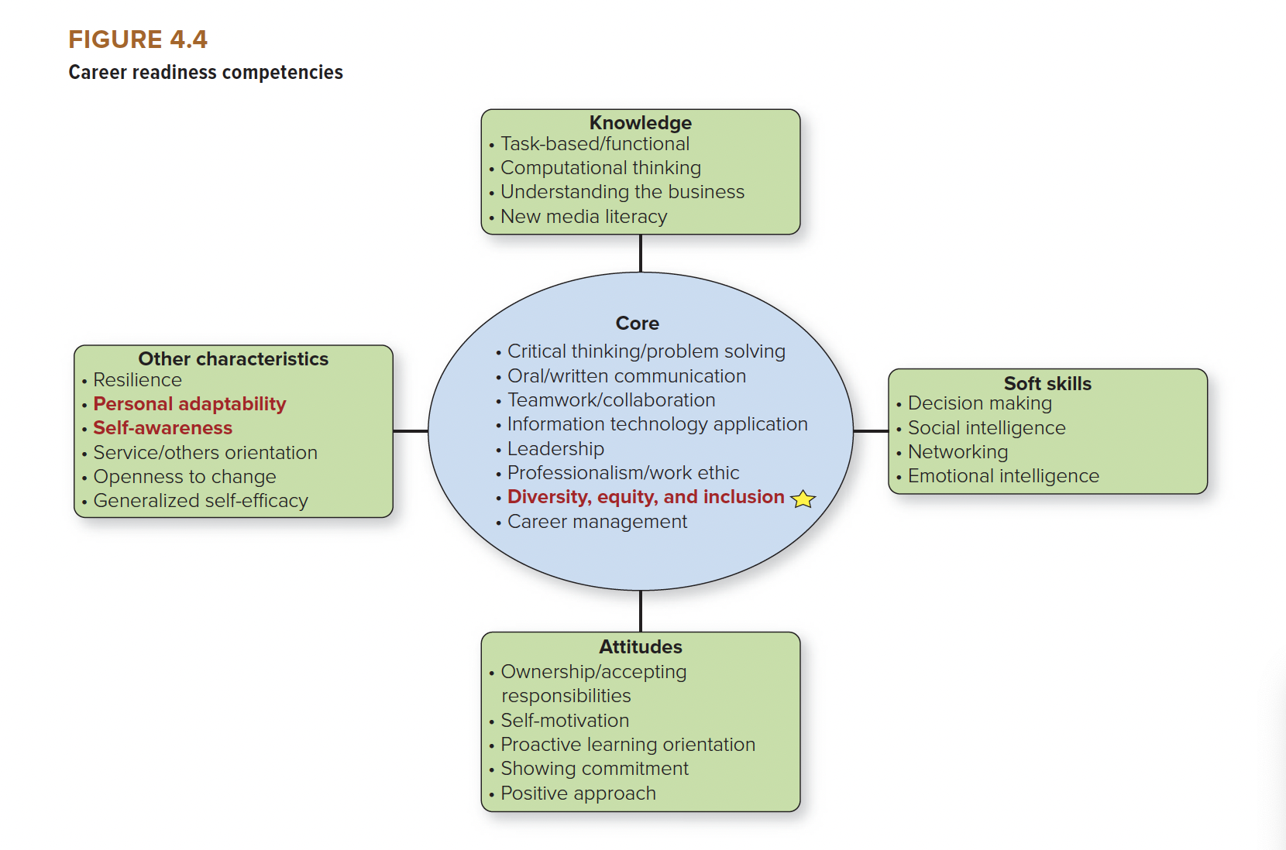
LO 4-6
MODEL OF CAREER READINESS
Access text description of slide image.
Notes:
SUMMARY
Students may believe that globalization does not affect their career readiness, but in our globally connected, 24/7 business environment, most students will participate in the global economy.
This chapter’s Executive Interview Series video featuring Fred Lund (SVP Global Development and Sustainability at Domino’s Inc), Alexis Garcin (Chairman & President, Michelin North America, Inc.), and Estella Woo (Director, Corporate Venture Building, Bosch North America) discuss the importance of career readiness skills related to global management. They emphasize whether you work in the United States or abroad, you need to understand, embrace, and use cultural awareness to enhance your personal and professional relationships.

Slide 39
CAREER CORNER:
MANAGING YOUR CAREER READINESS
Listen and observe:
  Try to take the perspective of a native.
  Look for cultural logic or set of values that may explain behavior.
Become aware of the context:
  Context refers to the situational or environmental characteristics that influence our behavior.
  Learn to read and adapt to the existing structure, rules, customers, and leaders in an unfamiliar situation.
Choose something basic:
  Try to learn another language if you plan to work overseas.
  A great way to start is by learning basic words and phrases that allow you to interact respectfully and politely.
Notes:
Enhancing The Career Readiness Competency of Diversity, Equity, and Inclusion
Listen and Observe.
Take the perspective of a native when interacting with others in a new cultural context. Listening and observing are the foundations of this kind of perspective taking.
Become Aware of the Context.
Context refers to the situational or environmental characteristics that influence our behavior. Increasing contextual awareness requires answering these four questions:
What do you know?
What don’t you know or understand?
What do you need to know or understand better?
How can you learn? What resources and support do you need?
Choose Something Basic.
Try to learn another language if you plan to work overseas or in a context where many people speak another language. Even a small effort shows respect and promotes cultural sensitivity.
Consider the different components of culture (e.g., language, religion, traditions, world events, etc.) and make an effort to expose yourself to a different component of a different culture on a regular basis.

Slide 40
End of Main Content

